Slide 1

Phishing Attacks Overview
Presentation by Your Name
July - 2025

Slide 2
Agenda
Definition
Types
Prevention
Detection
Impact
Case Studies
Future Trends
Recommendations

Slide 3

What Is Phishing?
Defining Phishing
Phishing refers to a malicious act where cybercriminals impersonate trustworthy organizations or individuals. Their aim is to trick users into divulging sensitive information such as usernames, passwords, and credit card numbers. Commonly employed methods include deceptive emails, which contain links directing victims to counterfeit websites designed to harvest their data.

Slide 4
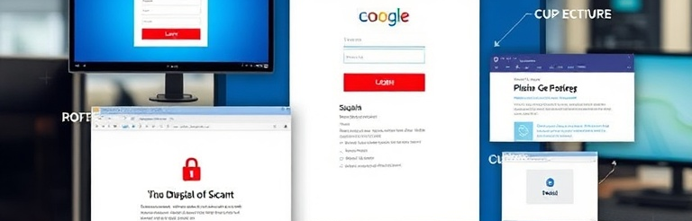
Types of Phishing
Spear Phishing
Email Phishing
Spear phishing targets specific individuals or organizations through tailored attacks that often leverage personal information. This strategy increases success rates, making it a dangerous form of phishing.
Email phishing exploits users by sending deceptive messages that appear genuine, urging them to provide sensitive information. This technique is widespread and poses a significant threat to online security.

Slide 5
Prevention Strategies
Technical Solutions
User Awareness
Security Policies
Utilize robust security systems, including firewalls and advanced email filters, to block potential phishing threats effectively.
Educate employees on spotting phishing attempts, focusing on common techniques and red flags to enhance security at all levels.
Create comprehensive security protocols for handling suspect emails, ensuring everyone understands their responsibilities in prevention.

Slide 6

Detection & Response
This section covers how to identify phishing attempts and strategies for responding effectively, ensuring that both immediate and long-term recovery measures are understood.

Slide 7
Case Study & Conclusion
This table highlights a real-world phishing case and the subsequent adjustments made to improve security protocols. Key takeaways include the importance of user training.
CASE STUDY | LESSONS LEARNED
Email Compromise | Strengthened security features
Spear Phishing Attack | Increased user training and awareness

